Slide 1


ICON for UK military families overseas
Clare Henderson
Specialist Health Visitor
SSAFA
British Forces Cyprus

Slide 2

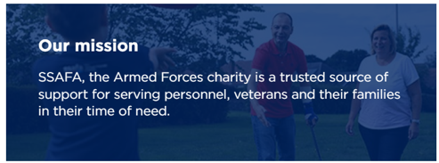
Who are SSAFA?
SSAFA is a tri-service military charity which supports serving personnel, veterans and their families.
SSAFA also has a commercial arm which provides community health services to military families posted overseas and social work services to RAF personnel in the UK, both under contract to the Ministry of Defence.

Slide 3
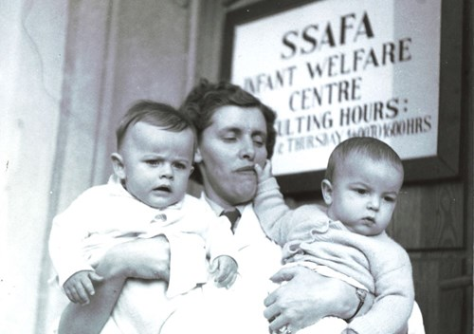
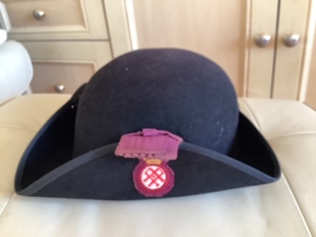

130 years of SSAFA Nursing

Slide 4
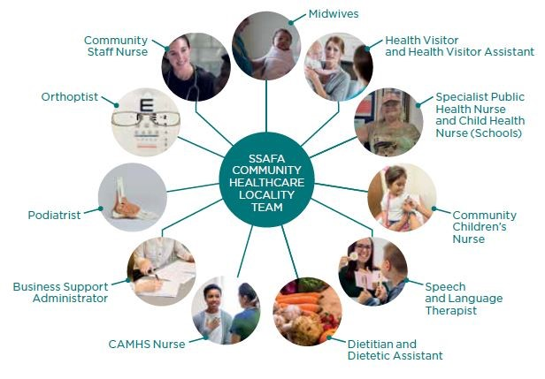
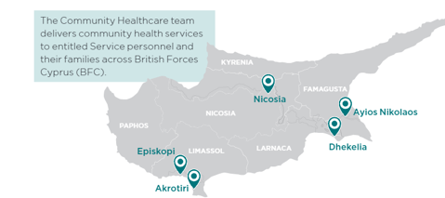
SSAFA in British Forces Cyprus
SSAFA Staff work across 4
main bases within Cyprus: -
Akrotiri
Episkopi
Dhekelia
Agios Nikolaos

Slide 5

UK Best Practice & the Healthy Child Programme
We offer extra services provided by a variety of community health staff, these include:-
Childhood and Pregnancy Immunisations
Co-deliver (with a Social Worker) Level 3 Safeguarding Training to members of the BFC community
Newborn Hearing Screening
Baby massage courses
Solihull Understanding your Baby/ Understanding your Child courses

Slide 6
Benefits of an overseas military tour
Service spouses attendance at appointments
High number of male partners attending Antenatal Appts
All spouses/partners entitled to paternity/maternity leave
Every family has an income
Every family has a house/bungalow
A local MOD school place for children over 3yrs on Universal Offer
Through Covid no one lost their job, and serving person was able to work from home
Families often report greater, good quality family time

Slide 7
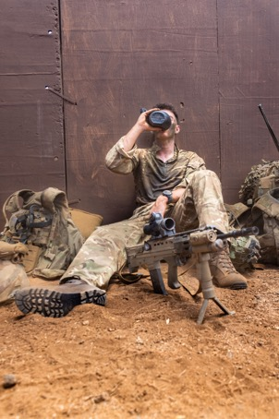
What makes an overseas posting different?
Family support
Culture & language
MoD schools
Primary care & dentistry
Secondary care provision
Job opportunities
Deployments
UK MOD © Crown
copyright 2022

Slide 8
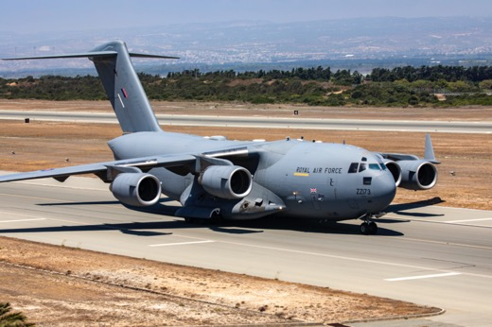
What makes an overseas posting different?
Tenuous friendship groups
Postal services
Geography
Availability of groups & classes
Cost of living
Weather
Possessions
UK MOD © Crown copyright 2022

Slide 9
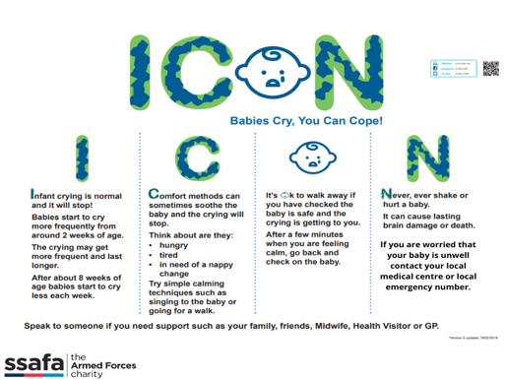
ICON Roll-out
Public Health campaign in support of MoD
Staff training – inclusion of additional disciplines
Schools & Youth services
Messaging within military context
Reviewed pathways across locations
Easy access resource pack for our team

Slide 10

Delivery of ICON resources to Military Families
Direct contact with dads (spouses)
Baby clinics
HV 6 week review
Baby massage
Solihull Understanding your Baby course
eRedbook

Slide 11
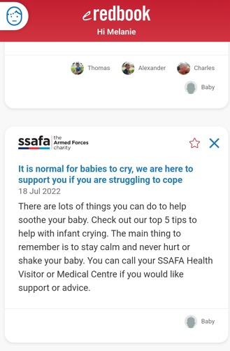
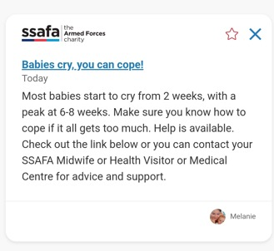
Electronic child health record – ‘eRedbook’
ICON content appears at key points:
Antenatally 28-32
2 & 4 weeks
Every 4 weeks until 10 months

Slide 12

Specific feedback already received
During a recent Understanding your Baby Course,
one parent specifically thanked the facilitators for
helping her to understand crying and get her through
that difficult time.

Slide 13


