Slide 1

ICON
Engaging dads on NICU

Slide 2
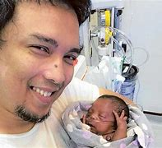

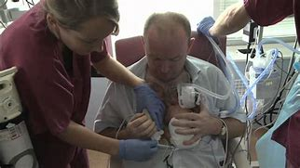
A neonatal experience is always extremely difficult, and often traumatic. There can be many barriers which prevent parents from being with their baby.
Babies have the very best long-term developmental outcomes if their parents have unrestricted access and are able to be partners in delivering their baby's care on the neonatal unit.

Slide 3
“Dads can sometimes get a little bit forgotten about, and they can sometimes forget about themselves too.”
* When a baby is admitted to NICU
Dad’s and partners struggle-How do NICU staff reach out
How can dads access support
Dad’s often hide their feelings-worry for the baby/partner
Feel stress/anxiety/under pressure-work/family responsibilities/other children
Becoming a dad and welcoming a baby into the world should be one of the happiest moments in life.

Slide 4
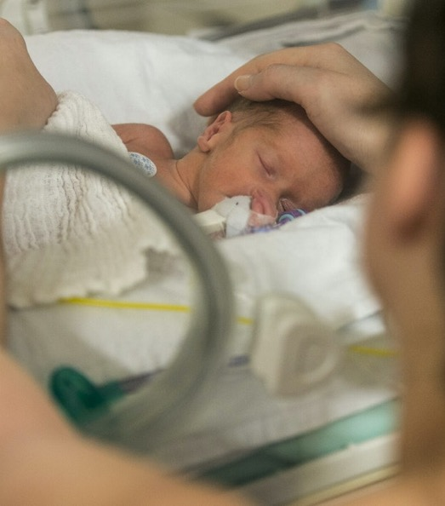
Covid pandemic
Neonatal Visiting restrictions
2020 NHS England Guidance tells hospitals to facilitate parental access at all times of day in neonatal services
Having a baby in neonatal care is emotionally challenging for all parents, but for parents whose babies have been born since the start of the COVID-19 pandemic, it’s been even harder. Ongoing neonatal access restrictions have had a serious impact on families.
Parents have been unable to be with their baby as much as they need to be and some parents - often fathers and partners - have been unable to spend time with or be involved in their baby’s care at all.
Therefore, affecting bonding and attachment as well as parental mental health. Secure attachment and bonding is critical for securing strong parent infant bonds which in turn ensure that babies, and their families, have the very best long-term outcomes.
Many dads find it difficult to talk about their feelings and often experience a sense of guilt when separated from their partner and baby.

Slide 5
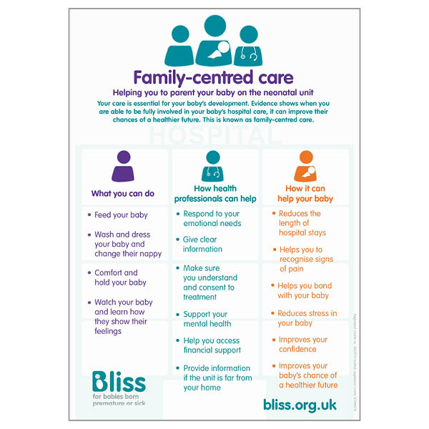

Slide 6
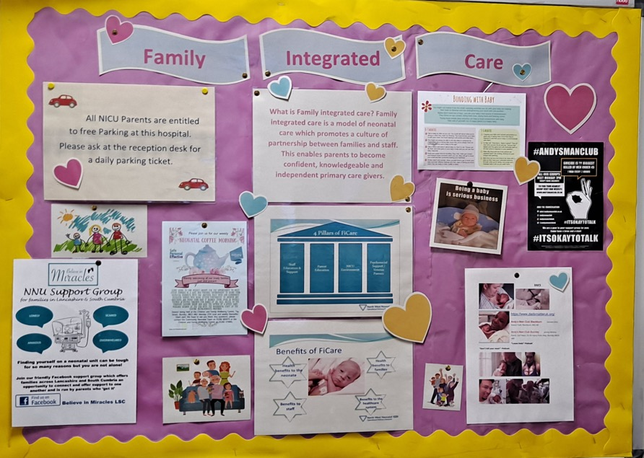

Slide 7
How we support dads on NICU
New dads: getting involved with their new-born
Dad’s might feel overwhelmed at first, but brand-new dads come fully equipped for fatherhood. Fathers are just as good as mothers at recognising and responding to the needs of their new-born's. They’re also just as able to care for older children.
Encourage dads to try everything:
Dressing, settling, playing, bathing and nappy changing – these are all great ways to bond with their baby. Parenting skills are partly a matter of practice – explain they get better and more confident the more hands-on experience they get.
Keep trying build their confidence and skills.
Spend one-on-one time with baby
This is a really important part of developing a strong and lasting bond.
Show their affection
When they show their baby affection and respond to their baby’s cues, a natural hormone called oxytocin is released in baby’s brain. This hormone makes the baby feel good. It also builds connections between nerve cells, stimulating brain development.
Dad’s can also imitate your baby’s facial expressions – frowns, tongue-poking, sounds and smiles. All this helps the bonding and attachment between dad and baby.
Talk with and sing to baby
While they’re caring for baby, try talking to baby .Reading to them

Slide 8
How we support dads on NICU
* Mental Health
* Attachment &Bonding
* Access to services
* consider individual needs and wants in family care plans
*ensure complete flexibility of access to the neonatal unit for fathers,
* gear parenting education towards co-parenting,
* actively promote father-baby bonding
* be attentive to fathers hiding their stress
* inform fathers directly not just via the mother
* facilitate peer-to-peer communication for fathers
* differentiate and analyse by gender in service evaluations
* train staff to work with fathers and to support co-parenting-don’t overlook estranged fathers
* develop a father-friendly audit tool
* Mental Health-dads are motivated to learn more about their partner’s wellbeing therefore this can help them be more aware of their own.
Access to services-there are services, organisations and interventions out there that will work for dads, but a lot of dads just don’t access it.
Attachment and Bonding in NICU-There is a lot of research that suggests dads are motivated to learn more about supporting their babies’ development supporting the father-baby bond and supporting co-parenting between the mother and the father benefits the health of the baby, for example, through improved weight gain oxygen saturations and enhanced rates of breastfeeding. Dads particularly report skin-to-skin care, in glowing terms of gratitude, happiness and love by nurturing and protecting the baby
Fathers, however, are subject to different social expectations from mothers and this shapes how they respond to the situation and how neonatal staff treats them.
Literature/Videos called “The Dad View” that you can find on YouTube channel
“Dad’s Matter” are a group set up by dad’s for dad’s they don’t isolate dads from services by replicating what they offer; instead they support dads to engage with already established pathways that will help

Slide 9
* Dad’s already feel isolated from services during the antenatal and postnatal period–Support can make sure that professionals work closely with services to make sure dads can reach them, compliment the support that is already out there for dads.
* ALWAYS ASK AGAIN – Even if dads are OK, or say they’re OK when you ask them, asking again, and again builds up a reassuring knowledge for the dad that you are a viable option for support. He might rely on this knowledge later – Dad’s can be supported in antenatal appointments, NICU, MBU, services, etc.
SIGNPOST AND SUPPORT ACCESS TO SERVICES – not every approach will suit every dad, so try to engage with as many other services and organisations as possible.
Try to make sure that they have information and education, resources and access to peer support that can help support their wellbeing earlier.
Early Intervention- help and Maternity Services, financial, housing, Social Care, baby groups, Early Attachment Service, Perinatal Mental Health Service, Home start, Coffee mornings
In house and collaborative training • APPGs • NHS England reference groups • Advocacy and Campaigning • Lived experience voices • Promoting Dad voices • Consulting professionals

Slide 10
Family social needs assessment
make active enquiries about the child’s father
* Who lives in the household-relationships
nicknames, aliases, be given false status, for example, ‘uncle’.
*Use different sources to gather information – the main carer of the child may be in a coercive/ controlling situation
Why aren’t ’hidden’ males included?
Lack of information sharing between adults’ and children’s services
Professionals involved with men who are fathers (such as substance misuse workers and probation officers) do not tend to share information about potential risks. They may be unaware the men have contact with their children
Relying too much on mothers for essential information-explain to mum the importance of the role of the significant other in the child’s life
Professionals sometimes rely too much on mothers to tell them about men involved in their children’s lives. If mothers are putting their own needs first, they may not be honest about the risk these men pose to their children.
Professionals do not always talk enough to other people involved in a child’s life, such as the mother’s estranged partner(s), siblings, extended family and friends.
Not wishing to appear judgmental
Professionals can be reluctant to judge the decisions parents make about their personal and sexual relationships. Risks can however be posed to children by men who are in short-term, casual relationships with the mothers. Find ways of involving fathers/partners/significant others
Not involving significant people/others in the household: Professional curiosity. (partners current and ‘estranged’), siblings, extended family members and friends.

Slide 11
How do we provide parents with information on NICU
POSTERS
LEAFLETS
TV-DIGITAL SCREEN
QR Code
SIGNPOST TO SOCIAL MEDIA SITES
WEBSITES
DIRECT CONVERSATIONS PRE-DISCHARGE HOME
DIRECT CONVERSATIONS POST DISCHARGE HOME

Slide 12
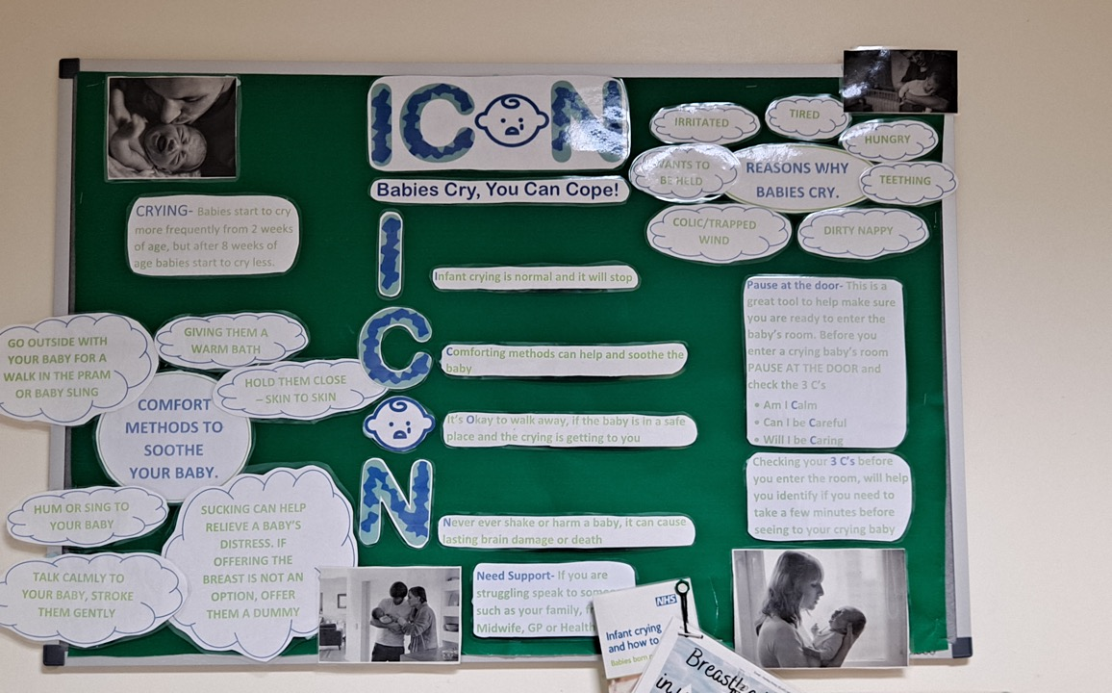

Slide 13
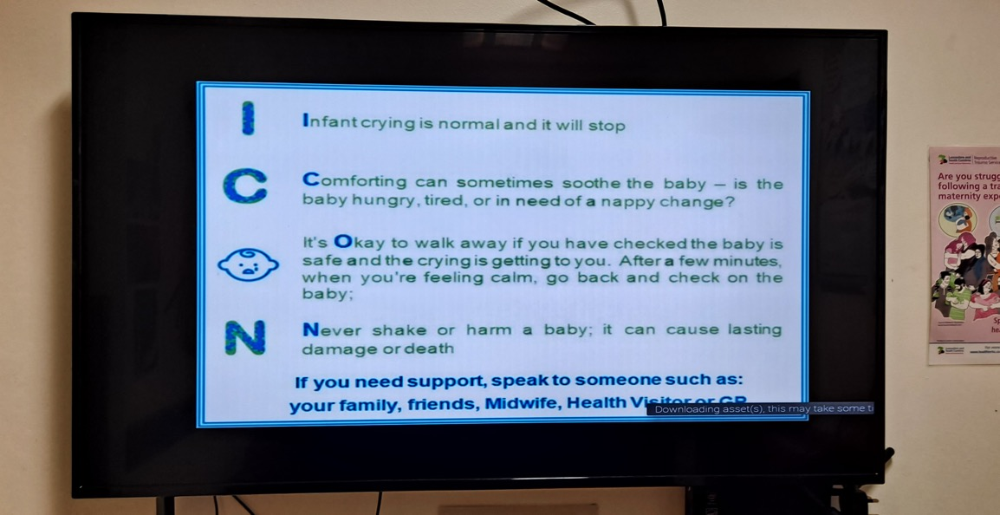

Slide 14

The campaign highlights the following Key Messages:
Infant crying is normal, and it will stop Comforting methods can sometimes soothe the baby. Is the baby hungry, tired, or in need of a nappy change? It's okay to walk away if you have checked the baby is safe and the crying is getting to you. After a few minutes, when you're feeling calm, go back and check on the baby Never shake or harm a baby; it can cause lasting damage or death If you need support, speak to someone such as your family, friends, Midwife, Health Visitor or GP

Slide 15
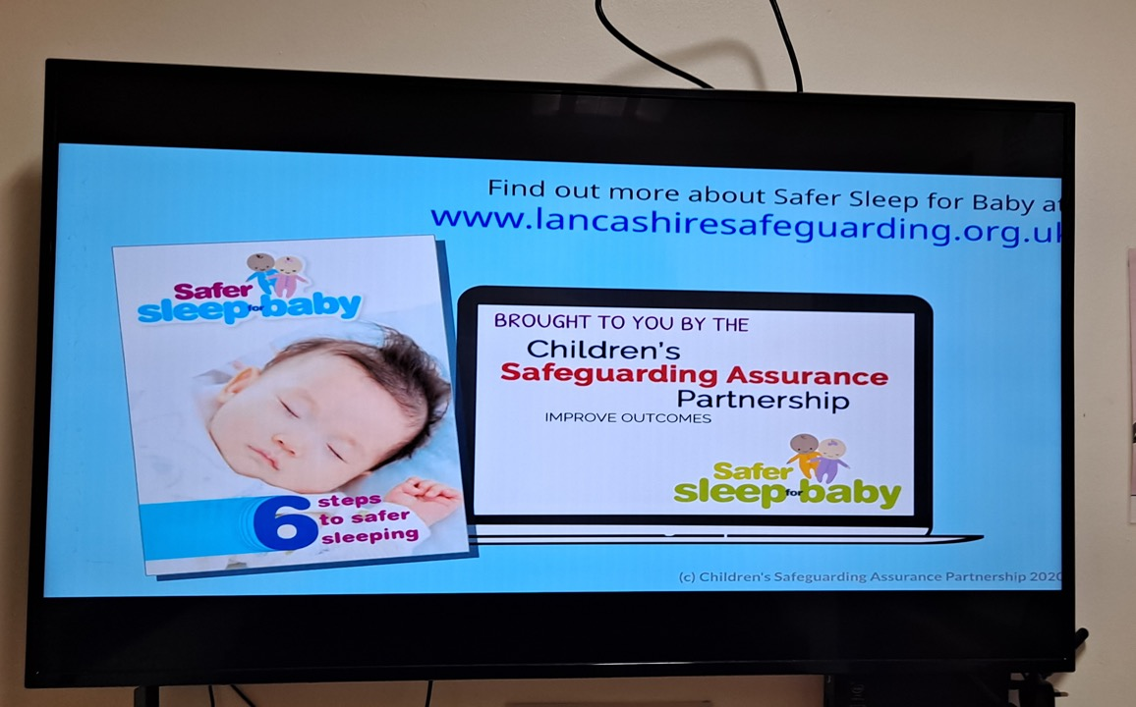

Slide 16
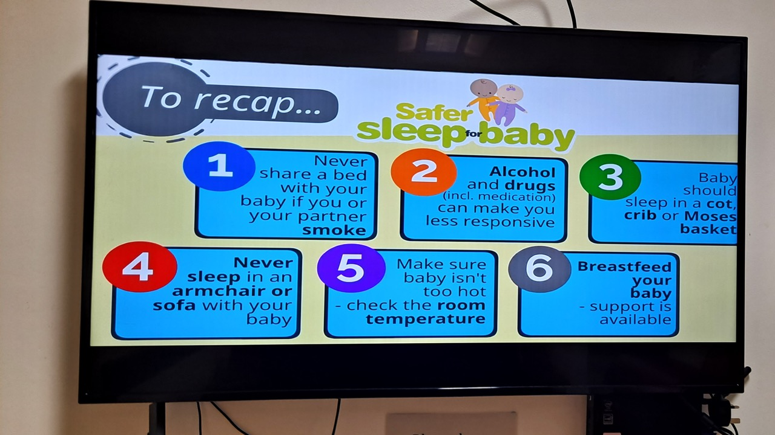

Slide 17
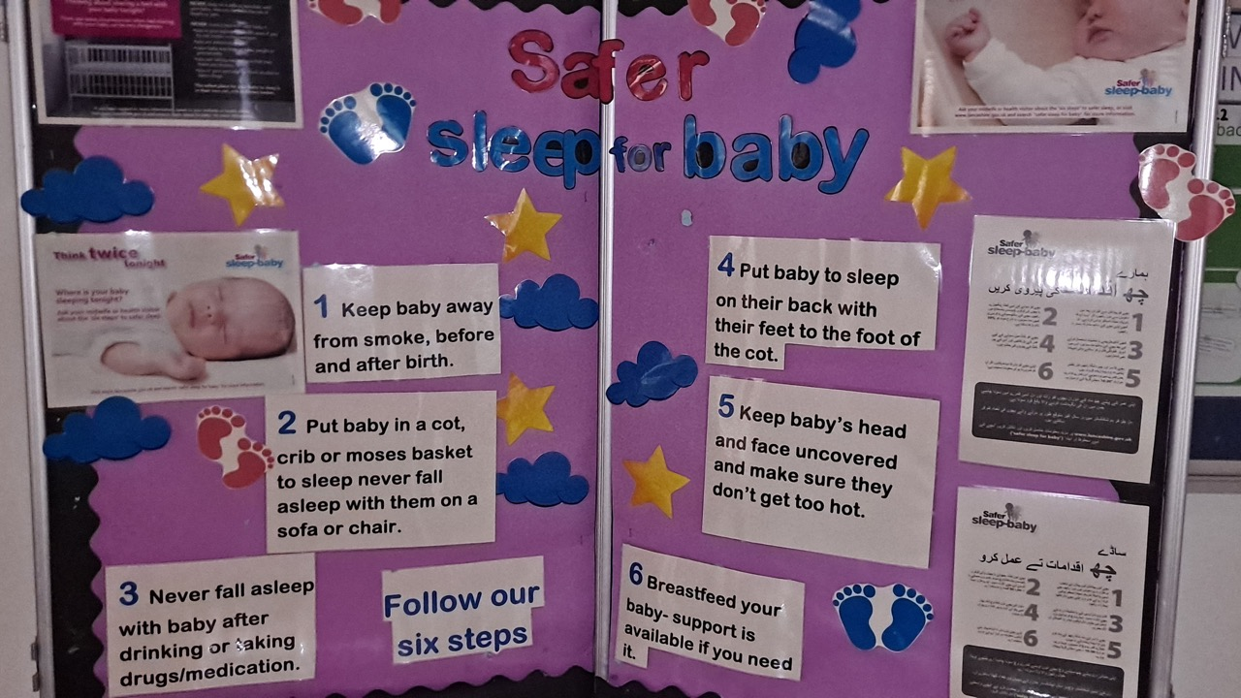

Slide 18
“For some fathers, the transition home is difficult especially when adding other factors such as caring for a medically complex child or transitioning to fatherhood following a pandemic. The challenge of bringing your precious little one home may not look how you pictured!”

Slide 19
Thank you
Gaynor Lovatt
Community Neonatal Team Leader
gaynor.lovatt@elht.nhs.uk
East Lancashire NHS Teaching Hospital Trust (ELHT)

